Slide 1



Cloud Technology and Blockchain Introduction
Instructors: Nihad Elili | Ismayil Eyyub

Slide 2
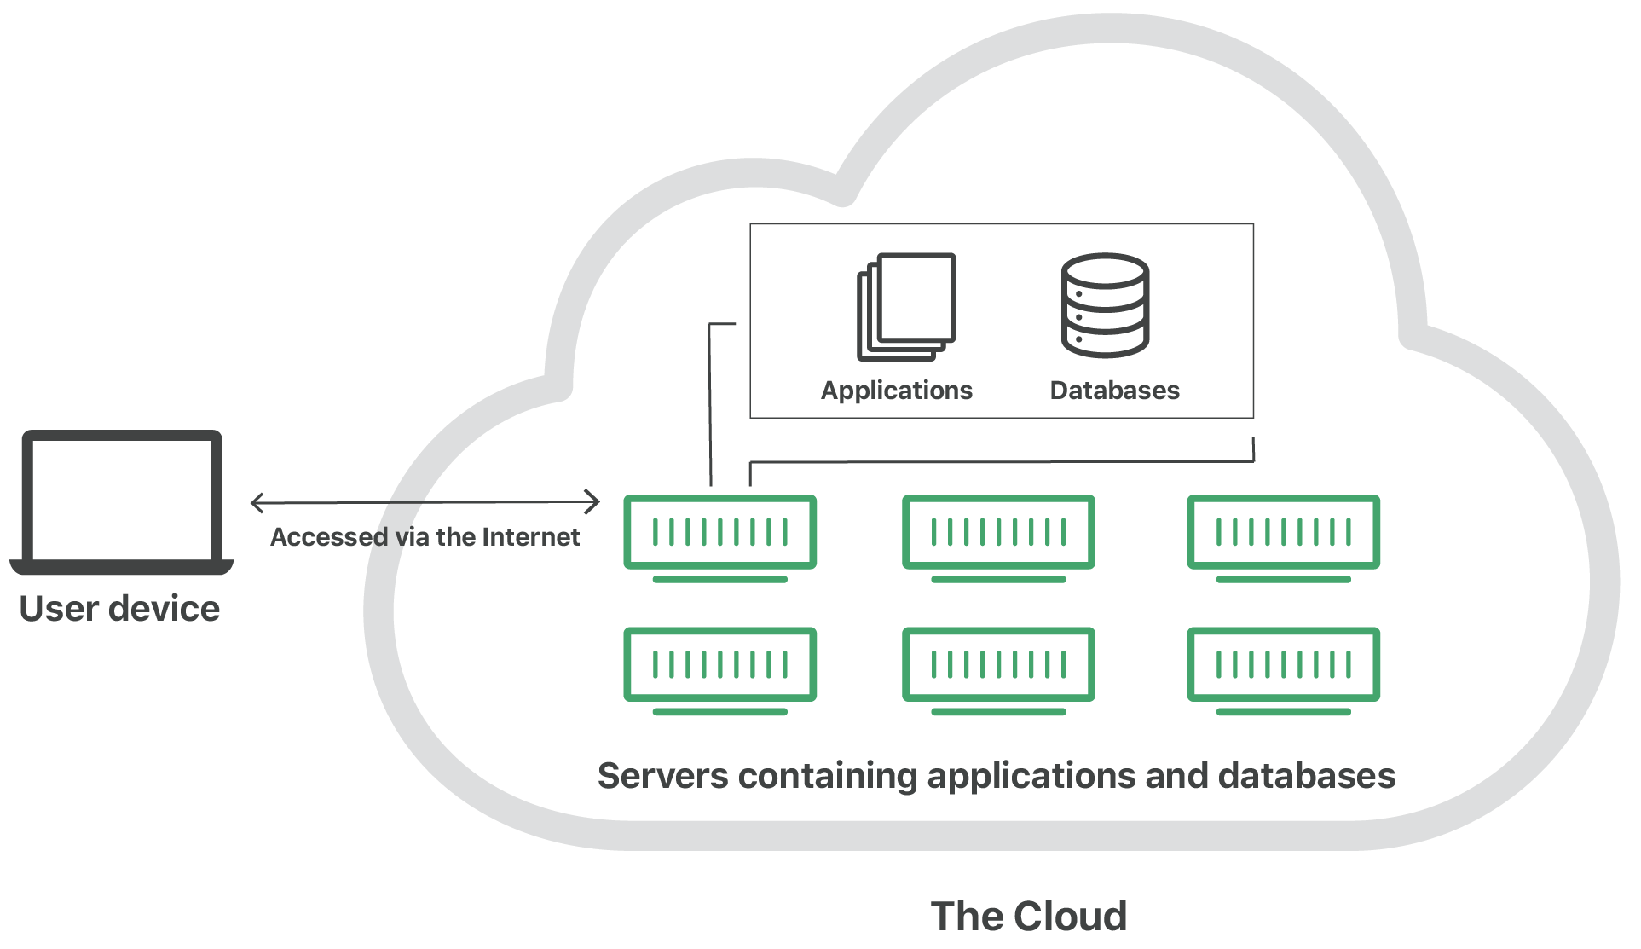
History of Cloud
"The cloud" refers to servers that are accessed over the Internet, and the software and databases that run on those servers.
Cloud servers are located in data centers all over the world.

Slide 3
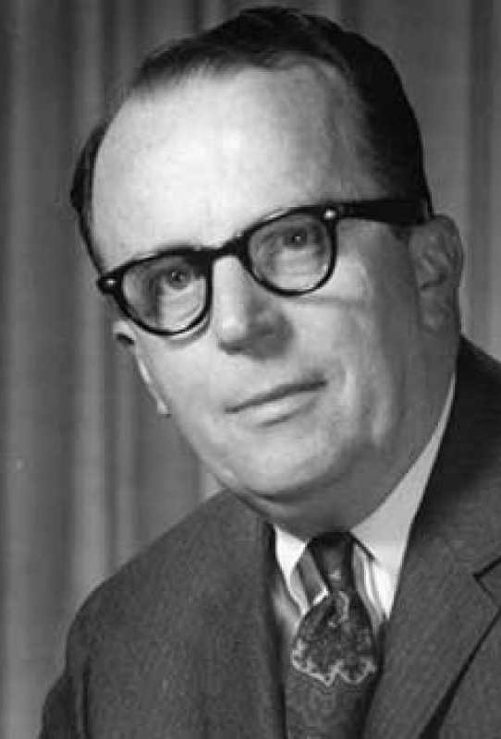
History of Cloud
J.C.R. Licklider introduced the idea of an "intergalactic computer network”.
He was serving as the head of Information Processing Techniques Office (IPTO) at the U.S. Department of Defense Advanced Research Projects Agency.
Although Licklider left IPTO in 1964, his successors and team were heavily influenced by his vision of a globally interconnected network of computers.

Slide 4
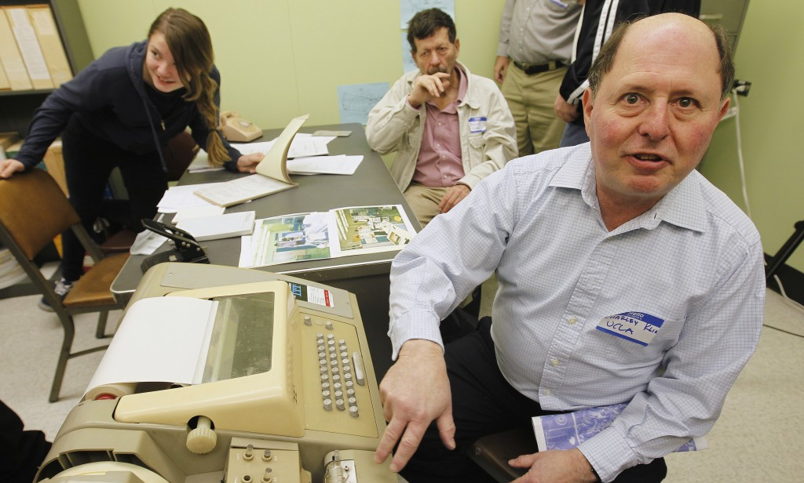
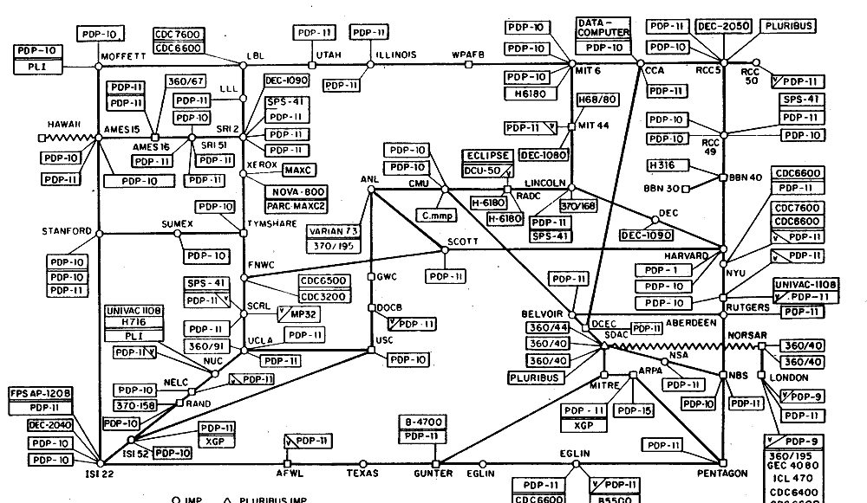
History of Cloud
The first computers were connected to ARPANET in 1969 and the Network Control Protocol was implemented in 1970.
The first message ever sent over the ARPANET was "LO," which was actually an incomplete attempt at "LOGIN." On October 29, 1969, Charley Kline, a student programmer at UCLA, tried to transmit the word "LOGIN" to a computer at Stanford Research Institute over the ARPANET. However, the system crashed after he typed in the "O," hence the first message was "LO."

Slide 5
History of Cloud
Robustness and Redundancy
Resource Sharing
Communication and Collaboration

Slide 6

History of Cloud
In the 1980s, as more networks joined this interconnected web and as commercial networks and ISPs (Internet Service Providers) emerged, the role of ARPANET diminished.
In 1989-1990, Tim Berners-Lee, a researcher at CERN, developed the World Wide Web.

Slide 7
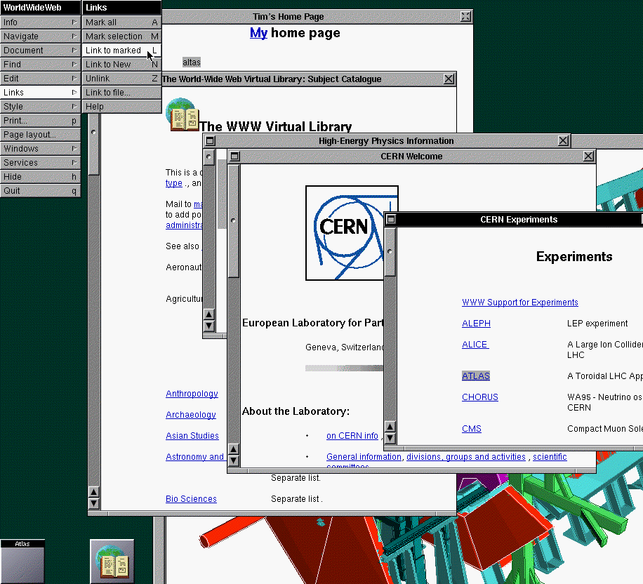
Virtual Machines
In the 1970s, the concept of virtual machines (VMs) became popular, allowing multiple distinct computing environments to reside in one physical environment.
VM technology increased the efficiency of servers and was a key component in the development of large-scale, reliable cloud computing services.

Slide 8
Virtual Machines
VM/370
VMware
Hypervisor
Cloud Computing
Microservices

Slide 9
Virtual Machines
Regular Computer
Virtual Machine
Application
Application
Application
VM
VM
VM
Application
Application
Application
Guest OS
Guest OS
Guest OS
Operating System
Virtual Machine Monitor (VMM)
Drivers
Drivers
Hardware
Hardware

Slide 10
Cloud Computing
One of the earliest examples of cloud computing in action was Salesforce.com, founded in 1999.
It revolutionized the software industry by delivering enterprise applications via a website.
This was a significant departure from the standard method of installing, running, and maintaining software on individual machines.

Slide 11

Cloud Computing
Amazon Web Services, launched in 2002, was another critical step in the development of cloud computing.
Initially, AWS provided a suite of cloud-based services, including storage, computation, and even human intelligence through the Amazon Mechanical Turk.

Slide 12
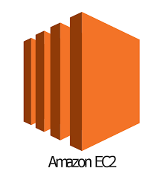
Cloud Computing
AWS launched its Elastic Compute Cloud (EC2) and Simple Storage Service (S3) in 2006.
EC2 allowed users to rent virtual computers on which to run their own applications, which was a groundbreaking idea at the time. S3 offered scalable storage in the cloud.
These services truly brought the concept of cloud computing to a broader audience and demonstrated its potential for scalability and flexibility

Slide 13
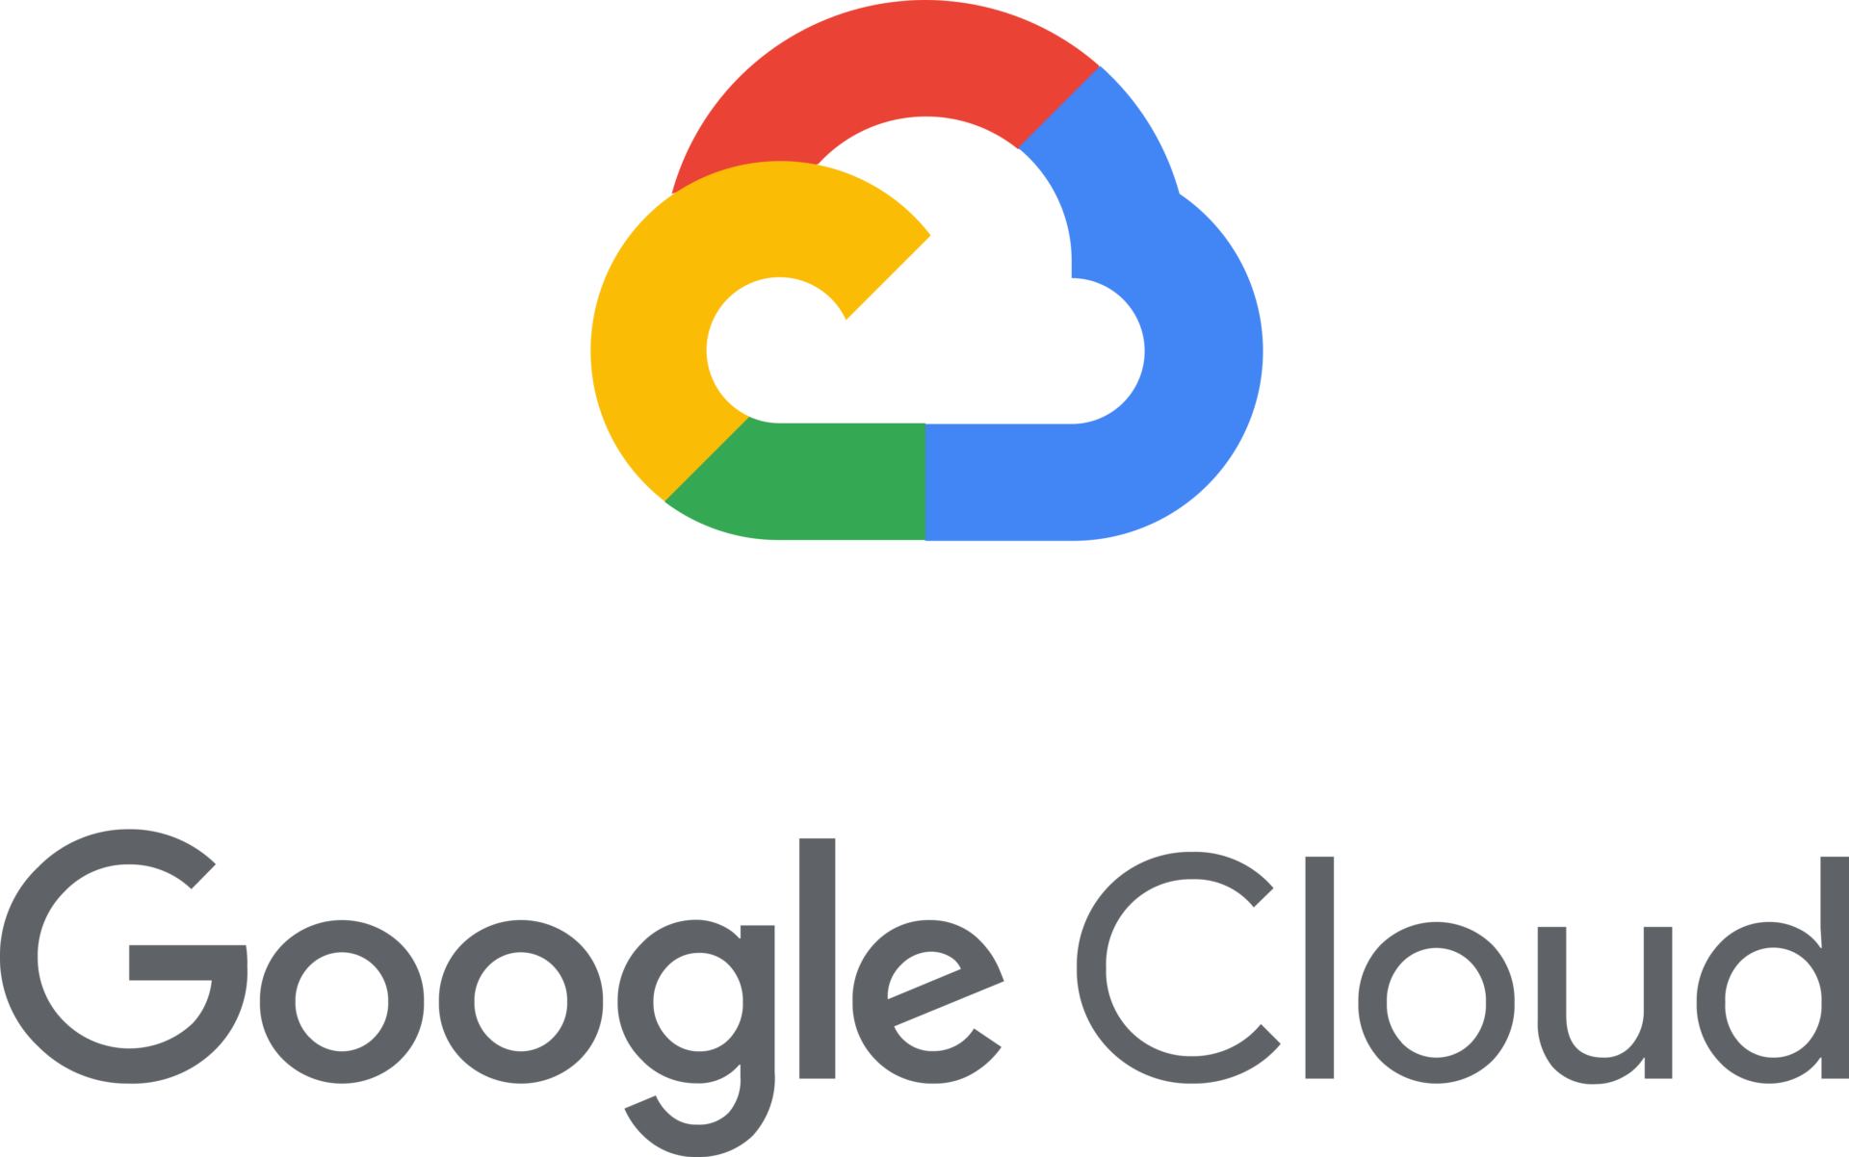
Cloud Computing
Google entered the cloud market in 2008 with Google App Engine, a platform for developing and hosting web applications in Google-managed data centers.
This further validated the cloud computing model, particularly for web and application development.

Slide 14
Containers
The concept of containerization in computing has its roots in the concept of process isolation. This dates back to the 1970s and 1980s with technologies like the Unix 'chroot' system call, introduced in 1979.
The next significant development came in 2000 with FreeBSD Jails. Jails expanded on the idea of simple process isolation to the partitioning of a FreeBSD computer system into multiple smaller systems, called 'jails'.

Slide 15

Containers
LXC, introduced in 2008, was a significant step forward, as it was one of the first, most complete implementations of container management through Linux namespaces and groups.
The real breakthrough in the popularization of container technology came with Docker in 2013. Docker made containers easier to use through automation and a high-level API, which provided a convenient way to create, deploy, and run applications.

Slide 16
Thank you for your attention
Cloud Technology and Blockchain
Instructors: Nihad Elili | Ismayil Eyyub

